Slide 1
Work with Tables and Database Records
Microsoft Access 2013
Lesson 3

Slide 2
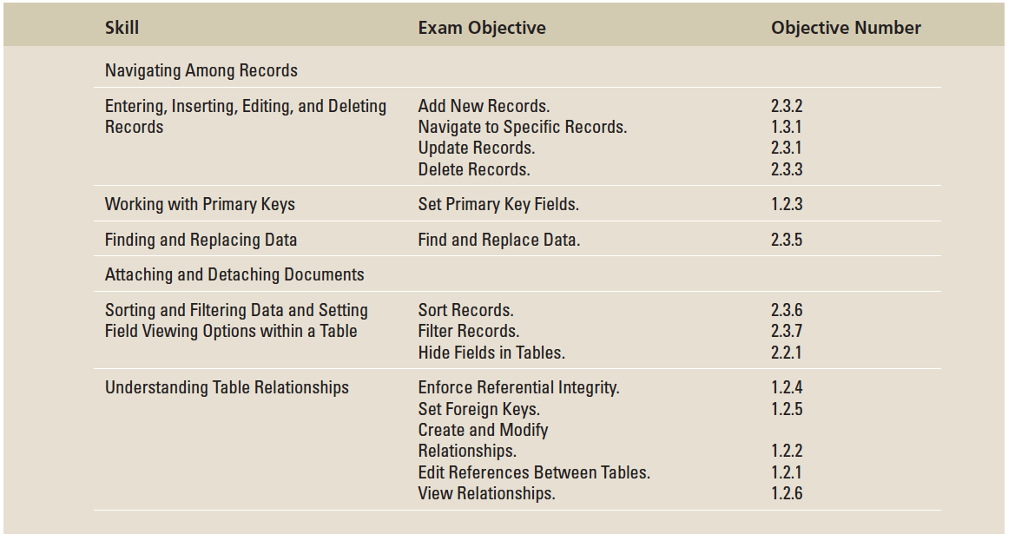
Objectives

Slide 3
Step by Step: Use the Keyboard to Navigate among Records
GET READY. Before you begin these steps, be sure to turn on and/or log on to your computer and start Access.
OPEN Fourth Coffee from the data files for this lesson.
Click the File tab, then click the Save As option on the left side of the Backstage view.
Click the Save As command. The Save As dialog box appears. Key FourthCoffeeXXX (where XXX is your initials) in the File name box. Find the location where you will save the solution files for this lesson and click Save.
In the Navigation Pane, double-click Coffee Inventory: Table to open the table.
Notice that the first cell of the first record is selected.

Slide 4
Step by Step: Use the Keyboard to Navigate among Records
Press the Down Arrow key to move down to the next row. Notice that the cell is selected.
Press the Right Arrow key to move to the Product Name field.
Press the Tab key to move to the next cell.
Press the Tab key to move to the next cell.
Press the Tab key to move to the next row.
Press Ctrl+Down Arrow to move to the first field of the last record.
PAUSE. LEAVE the database open to use in the next exercise.

Slide 5
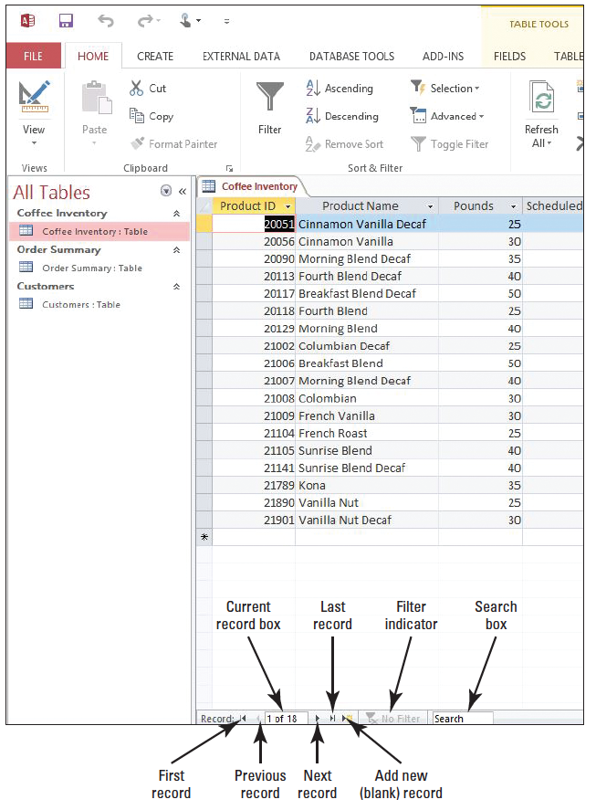
Step by Step: Use Navigation Buttons
USE the database open from the previous exercise.
Click the First record button (right). The selection moves to the first record.
Click the Next record button. The selection moves to the next record.

Slide 6
Step by Step: Use Navigation Buttons
Select and then delete the number 2 in the Current Record box. Key 5 and press Enter. The selection moves to the fifth record.
Click the Search box to position the insertion point. Key sunrise into the Search box. Notice that the selection moves to the first occurrence of the word Sunrise.
Press Enter. The selection moves to the next occurrence of the word Sunrise.
Click the New (blank) record button. The insertion point moves to the first column and last row of the table.
PAUSE. LEAVE the database open to use in the next exercise.

Slide 7
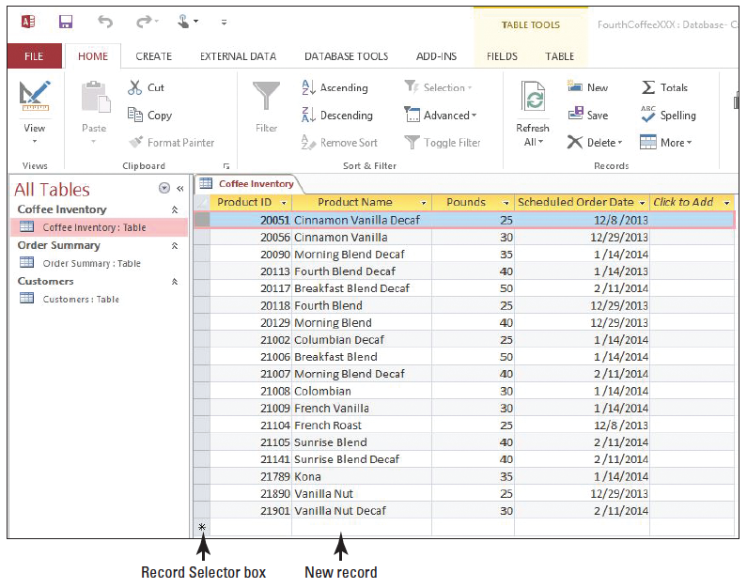
Step by Step: Enter, Edit, and Delete Records
USE the database you used in the previous exercise.
The insertion point should be positioned in the first field of the new, blank row at the bottom of the datasheet (right). Notice the asterisk in the Record Selector box, which indicates that this is a new record, ready for data.

Slide 8
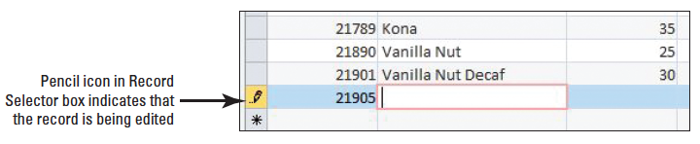
Step by Step: Enter, Edit, and Delete Records
Key 21905 and press Tab. Notice that the asterisk has changed to a pencil icon (below), indicating that the record is being edited.
Key Hazelnut and press Tab.
Key 30 and press Tab.

Slide 9
Step by Step: Enter, Edit, and Delete Records
Key 02112014 and press Enter.
Highlight sunrise in the Search box and key Kona to locate the Kona record.
Click Kona in the record to position the blinking insertion point there. Delete Kona and key Hawaiian and press Tab.
Click the Undo button on the Quick Access Toolbar. Notice Hawaiian disappears and Kona reappears.
Press Tab. Key 01142013 and press Tab.
Click the Record Selector box to the left of the Product ID field of the first record, 20051.

Slide 10
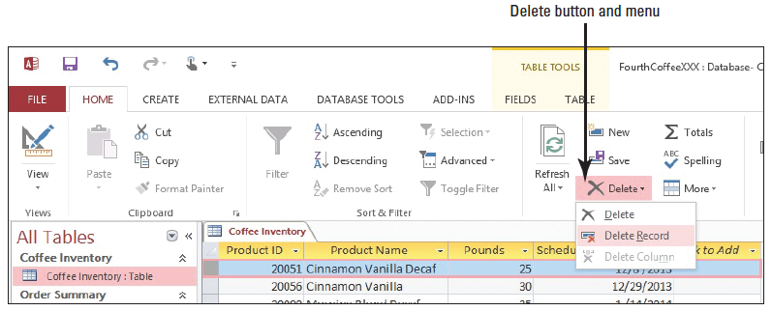
Step by Step: Enter, Edit, and Delete Records
On the Home tab, in the Records group, click the Delete button drop-down arrow. Select Delete Record from the menu (below).

Slide 11
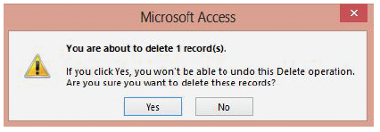
Step by Step: Enter, Edit, and Delete Records
A dialog box appears (below), asking if you are sure you want to delete the record. Click Yes.
Notice that the Undo button on the Quick Access Toolbar is not available beca use you cannot undo a record deletion. CLOSE the table.
PAUSE. LEAVE the database open to use in the next exercise.
Notes:
Take Note: You should be cautious when deleting record data. You cannot undo the deletion of a record.
Cross Reference: As you become more advanced in your knowledge of Access, you may want to create a delete query that can delete multiple records at once. You learn more about queries in Lesson 8.

Slide 12
Step by Step: Define a Primary Key
USE the database you used in the previous exercise.
In the Navigation Pane, double-click Order Summary: Table to open the table.
On the Home tab, in the Views group, click the bottom half of the View button, and from the menu that appears, select Design View.
Click the Row Selector box beside the Order ID row to select the row.

Slide 13
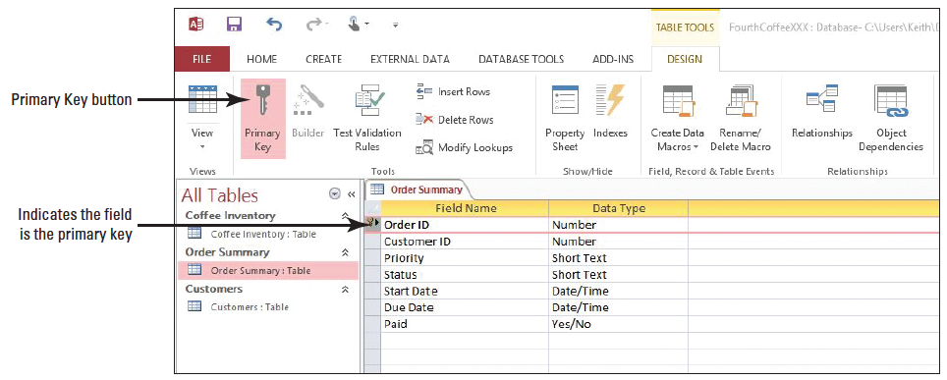
Step by Step: Define a Primary Key
On the Design tab, in the Tools group, click the Primary Key button. The Primary Key button is highlighted and appears to be pushed in. A key icon appears on the Order ID row to designate the field as a primary key.
PAUSE. LEAVE the table open to use in the next exercise.

Slide 14
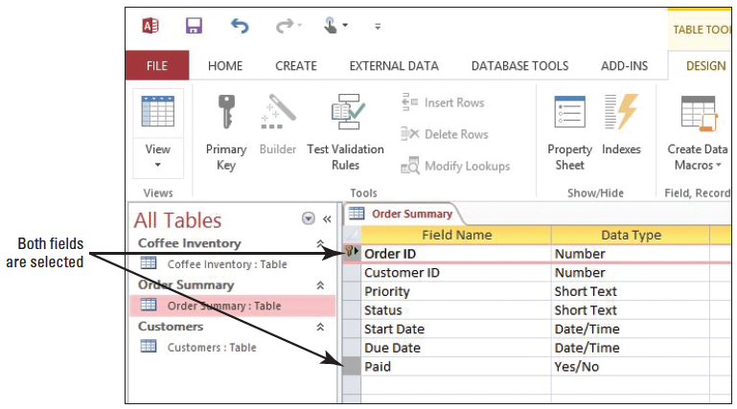
Step by Step: Define and Modify a Multifield Primary Key
USE the database open from the previous exercise.
Press and hold the CTRL key.
Click the Row Selector box beside the Paid row. Continue to hold down the CTRL key, and then click the Order ID Row Selector box. Both fields should be selected (above). If not, continue to hold the CTRL key, and then click the Paid Row Selector box again.

Slide 15
Step by Step: Define and Modify a Multifield Primary Key
On the Design tab, in the Tools group, click the Primary Key button. A key icon should be displayed beside both of the two selected fields. The combination of data from these two fields do not make a sensible composite key, and this designation will be removed.
With the rows still selected, click the Primary Key button again to remove the primary key designation from both fields.
Click on any field name to remove the selection.

Slide 16
Step by Step: Define and Modify a Multifield Primary Key
Click the Row Selector box beside the Order ID row. Press and hold the CTRL key, and then click the Row Selector box beside the Customer ID row. Both fields should be selected.
On the Design tab, in the Tools group, click the Primary Key button. Both rows should have a key displayed beside them. The resulting composite key is more valid.
Click the Save button on the Quick Access Toolbar.
Close the table.
PAUSE. LEAVE the database open to use in the next exercise.

Slide 17
Step by Step: Find and Replace Data
USE the database open from the previous exercise.
Open the Customers table.
On the Home tab, in the Find group, click the Find button. The Find and Replace dialog box appears with the Find tab displayed.
Click the Replace tab in the Find and Replace dialog box.
Key Elm into the Find What box.
Key Little Elm into the Replace With box.

Slide 18
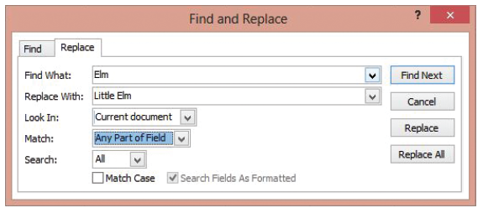
Step by Step: Find and Replace Data
Click the down arrow beside the Look in menu, and then select Current document, so that the entire table will be searched instead of just the Customer ID field.
Click the down arrow beside the Match menu and select Any Part of Field if it already is not selected to broaden the search (below).

Slide 19
Step by Step: Find and Replace Data
Click the Find Next button. Access searches the table, finds, and selects the word Elm.
Click the Replace button. Access replaces Elm with Little Elm.
Click the Find Next button. Access finds Elm in the new text that was just inserted.
Click Find Next again. Access displays a message saying that no more occurrences of the word have been found. Click OK.

Slide 20
Step by Step: Find and Replace Data
Click Cancel to close the Find and Replace dialog box.
Press the down arrow to remove the selection and allow Access to save the change.
Close the table.
PAUSE. LEAVE the database open to use in the next exercise.
Notes:
Take Note: If you want to use the Find and Replace dialog box to search for characters that are used as wildcards, such as a question mark, you must enclose that character in brackets, for example [?]. Follow this rule when searching for all wildcard characters except exclamation points (!) and closing brackets (]) where you would simply search for these without any surrounding brackets.

Slide 21
Step by Step: Attach and Detach Documents
USE the database open from the previous exercise.
Open the Order Summary table.
Click the header row of the Due Date field to select it.
In the Add & Delete group on the Table Tools Fields contextual tab, click the More Fields button. The More Fields menu appears.

Slide 22
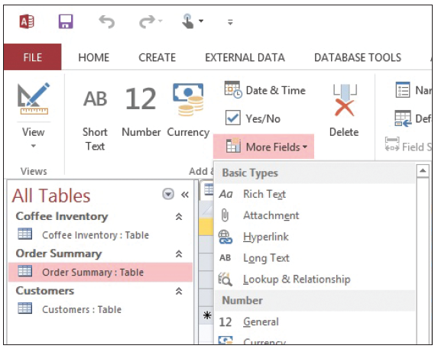
Step by Step: Attach and Detach Documents
Click Attachment under Basic Types (right). The Attach- ment field is inserted in the table.
Double-click the first row of the Attach- ments field. The Attachments dialog box appears.

Slide 23
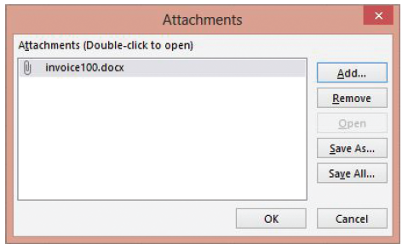
Step by Step: Attach and Detach Documents
Click the Add button. Navigate to the data files for this lesson and select invoice100.docx. Click Open. The document appears in the Attachments dialog box (below).

Slide 24
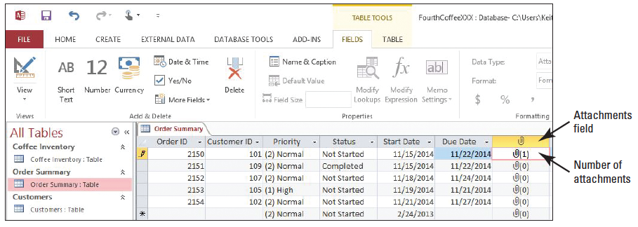
Step by Step: Attach and Detach Documents
Click OK. The number of attachments in the first record changes to 1 (below).
Double-click the attachment number in the Attachment field. The Attachments dialog box appears.

Slide 25
Step by Step: Attach and Detach Documents
Click the Open button. The attachment, an invoice document, opens in Microsoft Word.
Click the Close button to close the invoice document.
Click the Access button on the taskbar, if necessary, to return to Access.
In the Attachments dialog box, click the Remove button, and click OK. The attachment is removed from the record.
Close the Order Summary table.
PAUSE. LEAVE the database open to use in the next exercise.
Notes:
Take Note: Once a field has been set to the Attachment data type, it cannot be converted to another data type.
Cross Reference: The Add & Delete group and the More Fields menu will be covered in greater detail in Lesson 4.

Slide 26
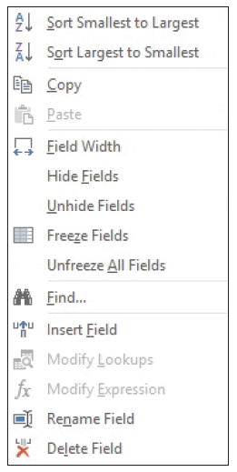
Step by Step: Sort Data within a Table
USE the database you used in the previous exercise.
Open the Customers table.
Click the header row of the Customer ID field to select it.
Right-click in the field to display the shortcut menu (right). Select Sort Largest to Smallest.

Slide 27
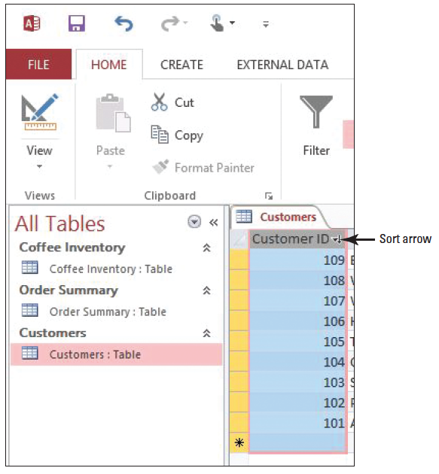
Step by Step: Sort Data within a Table
The data is sorted and an arrow is inserted in the header row (right), in- dicating that the data is displayed in sort order.
On the Home tab, in the Sort & Filter group, click the Remove Sort button. The sort is removed from the Customer ID field.

Slide 28
Step by Step: Sort Data within a Table
Select the First Name field. On the Home tab, in the Sort & Filter group, click the Ascending button. The data in the First Name field is sorted in ascending order.
Select the Last Name field. On the Home tab, in the Sort & Filter group, click the Ascending button. The data in the Last Name field is sorted in ascending order.
On the Home tab, in the Sort & Filter group, click the Remove Sort button. The sort is removed from both the First Name and Last Name fields.
Close the table. If a dialog box appears asking if you want to save changes to the table, click No.
PAUSE. LEAVE the database open to use in the next exercise.

Slide 29
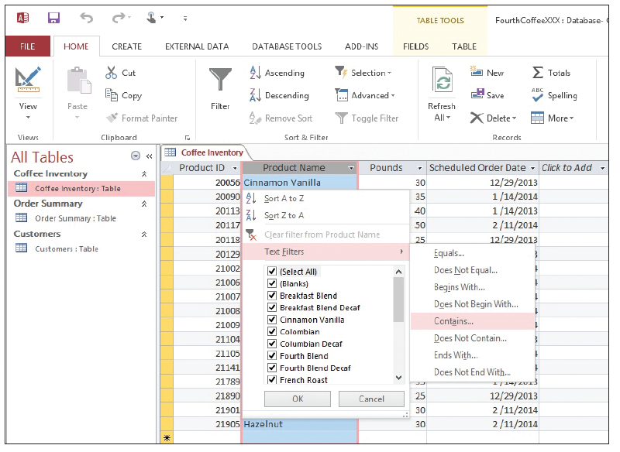
Step by Step: Apply a Filter
USE the database you used in the previous exercise.
Open the Coffee Inventory table.
Select the Product Name field. On the Home tab, in the Sort & Filter group, click the Filter button. A menu appears.
Point to Text Filters. A second menu appears. Select Contains (above).

Slide 30
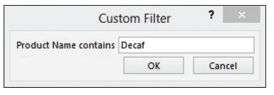
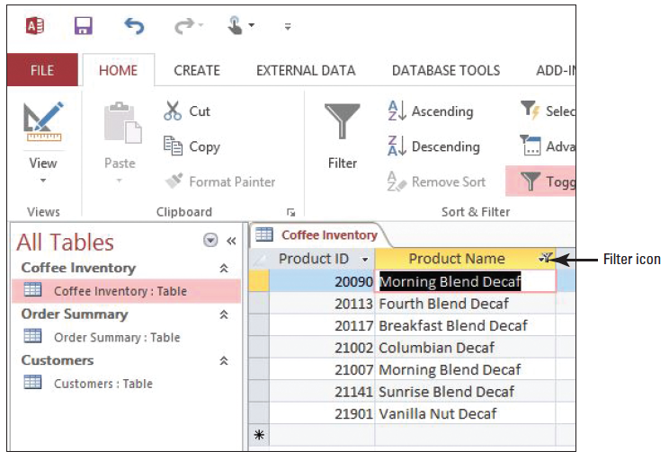
Step by Step: Apply a Filter
The Custom Filter box appears. Key Decaf (right), and click OK. Access filters the data- base to display only the records containing the word Decaf. A filter icon is displayed in the header row of the field (below).

Slide 31
Step by Step: Apply a Filter
Click the Toggle Filter button in the Sort & Filter group to display the records without the filter.
In the second record in the Product Name field, double-click the word Decaf to select it.

Slide 32
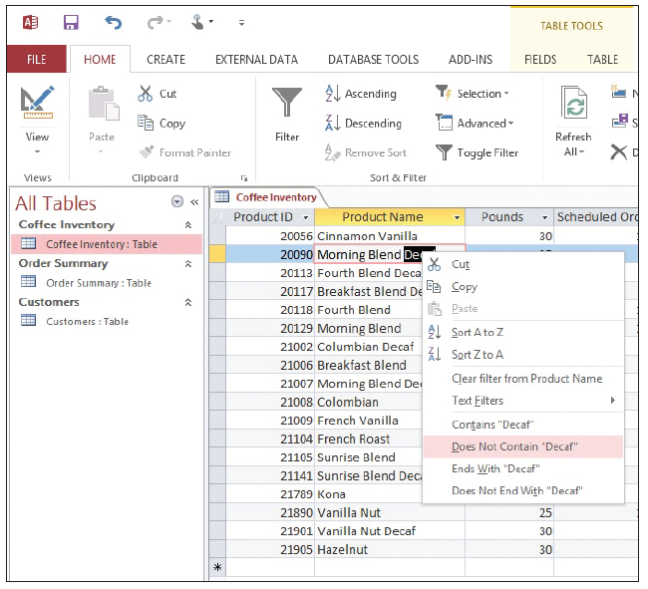
Step by Step: Apply a Filter
Right-click the word Decaf to display the shortcut menu. Select Does Not Contain “Decaf” (right). Notice that the records are filtered to show only those that do not contain the word Decaf.

Slide 33
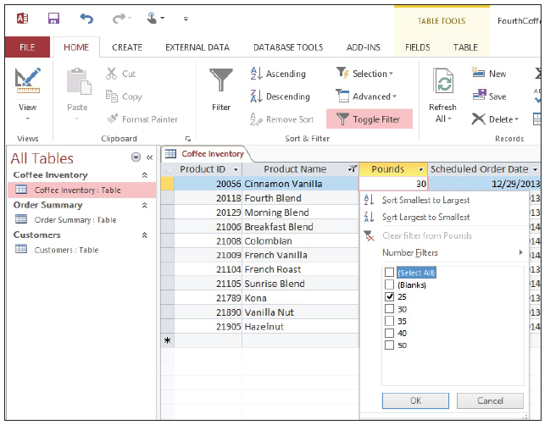
Step by Step: Apply a Filter
Click in the Pounds field of the first record.
On the Home tab, in the Sort & Filter group, click the Filter button.
Click the check boxes to remove the check marks beside (Blanks), 30, 35, 40, and 50 (right). Only the check mark beside 25 should remain.

Slide 34
Step by Step: Apply a Filter
Click OK. Access filters the records to show only those containing the number 25 in the pounds field.
Click the Toggle Filter button.
In the second row of the Scheduled Order Date field, highlight 1/14/2014 by clicking and dragging the mo use. Notice a ‘#’ appears after the ‘1’ in the month part of the selected date. This is a placeholder character that is part of the input mask field property for this field.
Notes:
Cross Reference: You learn more about input masks and how they help conform data to various formats in Lesson 8.

Slide 35
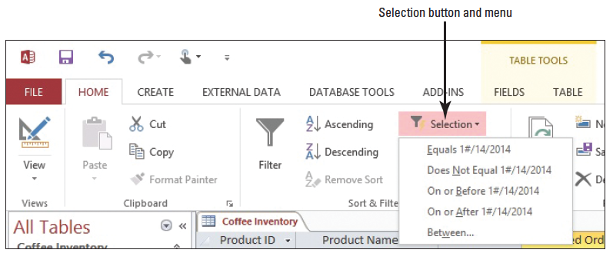
Step by Step: Apply a Filter
On the Home tab, in the Sort & Filter group, click the Selection button. A menu appears (below).
Select On or After 1/14/2012. The data is filtered to show only those records with content in the Scheduled Order Date field that matches the filter selection.

Slide 36
Step by Step: Apply a Filter
In the seventh row of the Pounds field, select 30.
On the Home tab, in the Sort & Filter group, click the Selection button. Select Less Than or Equal to 30. The records are filtered accordingly.
PAUSE. LEAVE the database open to use in the next exercise.
Notes:
Take Note: Only one filter can be applied per column. When you apply a filter to a column that is already filtered, the previous filter is removed and the new filter is applied.
Take Note: You cannot apply a case-specific filter. For example, filtering a table for “Decaf” will find all occurrences of the word “decaf” including “Decaf”, “decaf”, “deCaf” etc.

Slide 37
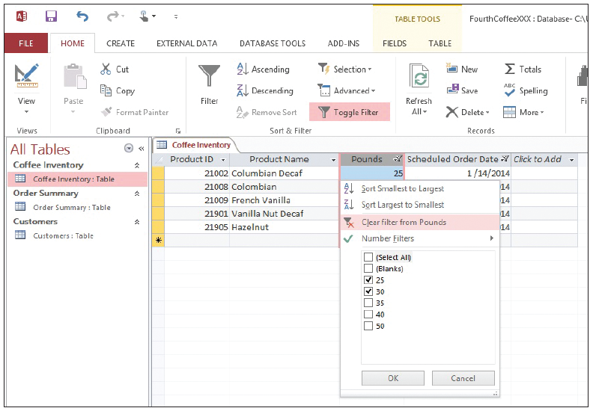
Step by Step: Remove a Filter
USE the table you used in the previous exercise.
Select the Pounds field. On the Home tab, in the Sort & Filter group, click the Filter button. A menu appears.
Select Clear Filter from Pounds (right).
On the Home tab, in the Sort & Filter group, click the Advanced button. A menu appears.

Slide 38
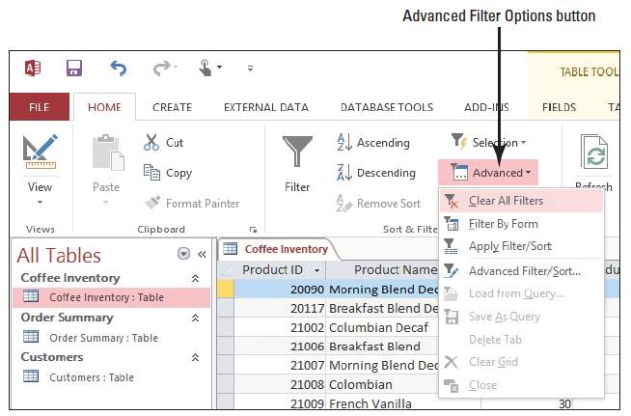
Step by Step: Remove a Filter
Select Clear All Filters from the menu (below).
Save and close the table.
PAUSE. LEAVE the database open to use in the next exercise.

Slide 39
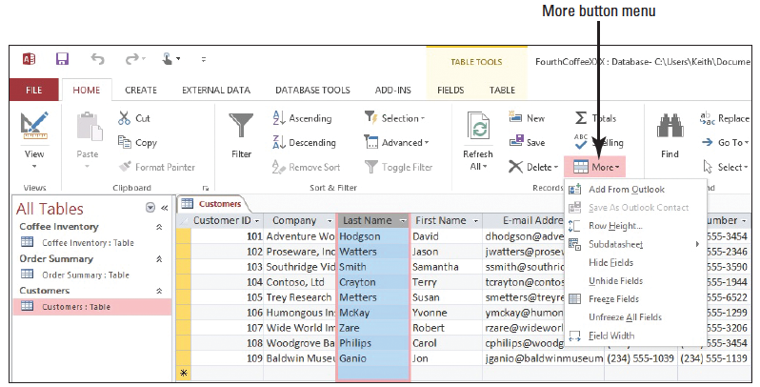
Step by Step: Freeze/Unfreeze and Hide/Unhide Fields
USE the database you used in the previous exercise.
Open the Customers table.
Select the Last Name field. On the Home tab, in the Records group, click the More button. A menu appears (below).

Slide 40
Step by Step: Freeze/Unfreeze and Hide/Unhide Fields
Select Freeze Fields. Notice that the Last Name field moves to the first field position in the table.
Click the Restore Down button on the application window (below). The Restore Down button now becomes the Maximize button. Press the Right Arrow key to scroll the table’s fields to the left, and stop when you reach the ZIP/Postal Code field. Notice that the Last Name field stays fixed as the other fields scroll.

Slide 41
Step by Step: Freeze/Unfreeze and Hide/Unhide Fields
Click the More button again and select Unfreeze All Fields. Notice how the Last Name field remains in the table’s first field position. Press the Right Arrow key several times until the Last Name field scrolls off from view. Notice how the Last Name field moved with the other fields when the Right Arrow key was pressed several times.
Click the Maximize button on the application window.
Notes:
Take Note: Fields can be rearranged in datasheet view by clicking on the field name headers and dragging them to where you want to move them.

Slide 42
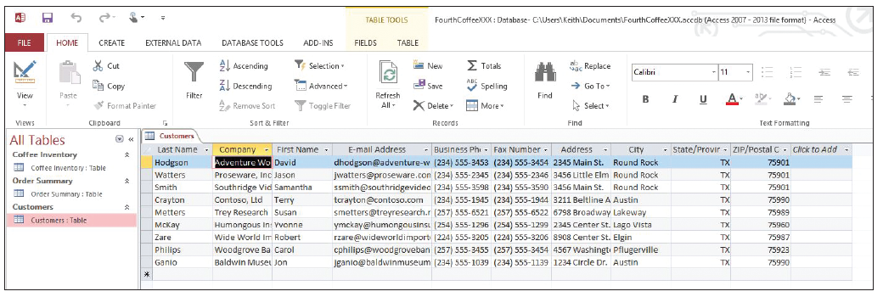
Step by Step: Freeze/Unfreeze and Hide/Unhide Fields
Select the Customer ID field. Click the More button and select Hide Fields. Notice the Customer ID field is now hidden from view (below).

Slide 43
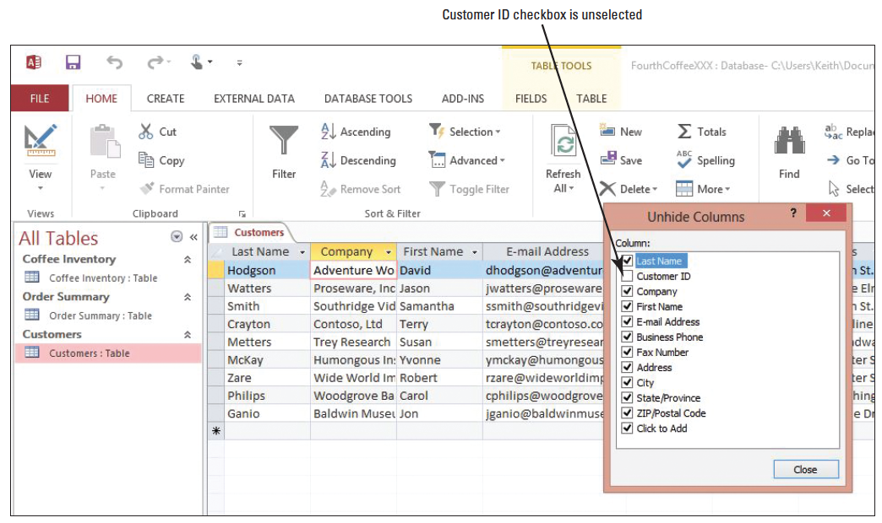
Step by Step: Freeze/Unfreeze and Hide/Unhide Fields
Click the More button and select Unhide Fields. The Unhide Columns dialog box should appear as shown below. Notice the check mark is missing from the Customer ID check box, signifying that it is hidden.

Slide 44
Step by Step: Freeze/Unfreeze and Hide/Unhide Fields
Deselect the check boxes next to all the other field representations except Last Name and Business Phone, and then click the Close button in the Unhide Columns dialog box. Notice the only fields now displayed in Datasheet view are the Last Name and Business Phone fields.
Close the Customers table without saving the changes to the layout.
PAUSE. LEAVE the database open to use in the next exercise.
Notes:
Take Note: You can save your table so it retains your formatting the next time you open it.
Take Note: To select more than one field to freeze or hide, hold down the shift key while selecting adjacent fields.

Slide 45
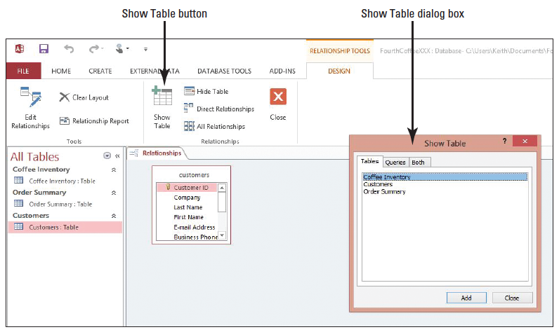
Step by Step: Define Table Relationships
USE the database you used in the previous exercise.
On the Database Tools tab in the Relationships group, click the Relationships button. The Relationships view appears with the Customers table represented.
Click the Show Table button. The Show Table dialog box appears (right).
Select Order Summary and click Add.

Slide 46
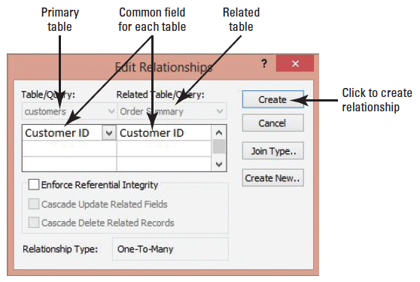
Step by Step: Define Table Relationships
Click Close. The Customer table and Order Summary table are represented in Relationships view.
Click the Customer ID primary key field in the Customers table, and then drag it to the Customer ID field of the Order Summary table and release the mouse button. The Customer ID field represents the common field between the two tables. The Customer ID field of the Order Summary table is now set as the foreign key. The Edit Relationships dialog box appears (above).

Slide 47
Step by Step: Define Table Relationships
Select the Enforce Referential Integrity check box. Then select the Cascade Update Related Fields and Cascade Delete Related Records check boxes.
Click Create. A relationship line representing the one-to-many table relationship of the Customers and the Order Summary tables is displayed (see the enxt slide). You just created a one-to-many relationship between these tables using Customer ID, the common field. The one-to-many relationship type signifies that each customer record in the Customers table can have many order records in the Order Summary table.
PAUSE. LEAVE the database open to use in the next exercise.

Slide 48
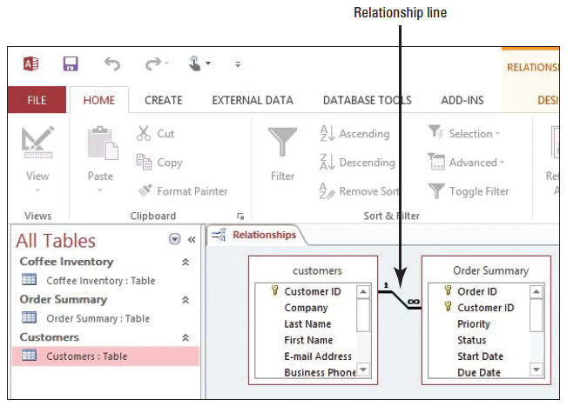
Step by Step: Define Table Relationships

Slide 49
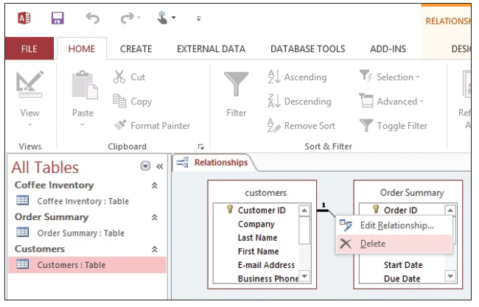
Step by Step: Modify Table Relationships
USE the database you used in the previous exercise.
Right-click the center section of the relationship line connecting the two tables. A menu appears (right).
Select Delete. A message appears asking if you are sure you want to delete the relationship. Click Yes. The line disappears.

Slide 50
Step by Step: Modify Table Relationships
Select the Customer ID field in the first table. Drag the mouse to the Customer ID field in the second table and release the mouse button. The Edit Relationships dialog box appears.
Click the Create button. A line appears, creating the relationship.
Double-click the center section of the relationship line. The Edit Relationships dialog box appears again, listing the tables and the Customer ID fields on each side.

Slide 51
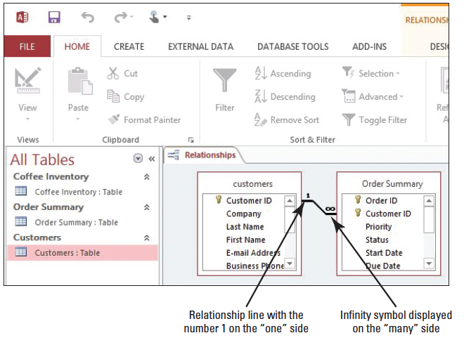
Step by Step: Modify Table Relationships
Click the Enforce Referential Integrity box and click OK. The line appears thicker, with the number 1 beside the first table and the infinity symbol (∞) beside the second (right).
PAUSE. LEAVE the database open to use in the next exercise.

Slide 52
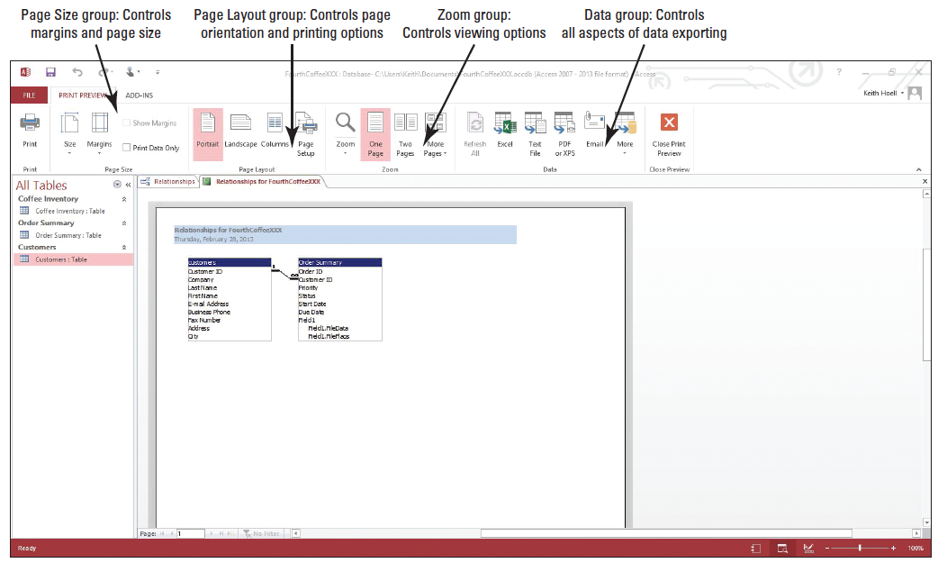
Step by Step: Print Table Relationships
USE the database you used in the previous exercise.
In the Tools group of the Relationship Tools Design tab, click the Relationship Report button. The report is created and the Print Preview tab appears (below).

Slide 53
Step by Step: Print Table Relationships
Click the Print button. The Print dialog box appears, allowing you to select the printer you want to use.
Click OK to keep the default settings, and then print the report.
Click the Close button to close the Relationships for FourthCoffee tab. A message appears asking if you want to save changes to the report. Click No.
Close the Relationships tab.
STOP. CLOSE the database.

Slide 54
Skill Summary

